Slide 1
Thessaloniki Meeting: 30 October – 1 November 2019
Α Postgraduate Course on Research Methodology for Engineers and Scientists
Pericles Latinopoulos Professor Emeritus Aristotle University of Thessaloniki

Slide 2
The focus of the paper
Structure and implementation issues of the course
“INTRODUCTION TO
RESEARCH METHODOLOGY”
Operated by the School of Civil Engineering, AUTh (since 2005)
Aiming at initial provisions of knowledge and skills training
Complementing the indisputable role of the PhD’s supervisor
A 10-week seminar-type module
Compulsory for new doctoral students (1st year - 2nd semester)
Also compulsory for MSc students (EPSD program)

Slide 3
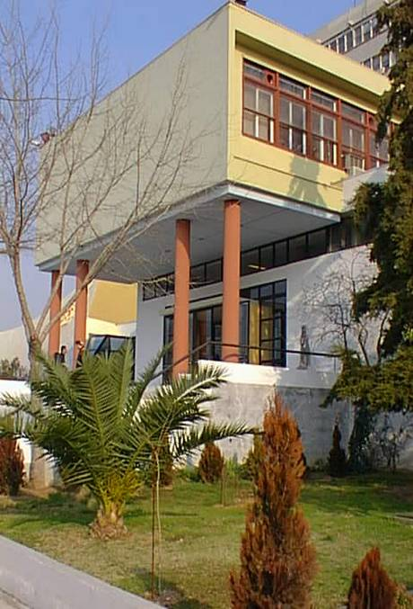
Design and organisation of the course
Aims and objectives
The familiarisation with basic issues & principles of research
The development of necessary related skills and competencies
Learning outcomes
Knowledge outcomes
Skills outcomes

Slide 4
Design and organisation of the course
Learning outcomes
Knowledge outcomes
Skills outcomes
knowledge of basic concepts of research and innovation
understanding the principles of ethical conduct of research
apprehension of research processes
familiarisation with research activities in sciences and engineering
recognition of concepts, principles and sources of technical terminology
acquaintance with ways and forms of communicating research results
research design and organisation
(recognize problems, use scientific method)
research environment
(conduct, ethics, rights, exploitation)
literature management
(identify/access bibliography sources, use information technology tools)
communicating research
(effective use of forms and levels, written, oral and supporting material)
teamworking
(working relations, personal behaviors)
time management
(setting goals & priorities, planning, scheduling, revising)

Slide 5
Design and organisation of the course
Educational methods and material
Educational method
Educational material
lectures
creative activity
active learning
self-education
lectures’ PPT’s
informative material
guidelines & examples
completed assignments
Assignments
Students’ assessment
one general assignment
(teamwork)
two specific assignments
(personal work)
overall presence & activity
contribution in general assignment
performance in specific assignments

Slide 6
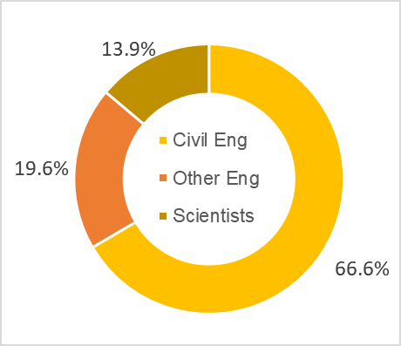
Implementation of the course
Class participation and attendance
joint teaching: PhD & MSc students
joint teaching: civil engineers & other disciplines graduates
proportions of the individual groups are more or less conditioned on enrollment particulars & regulations
civil engineers are double the sum of other graduates

Slide 7
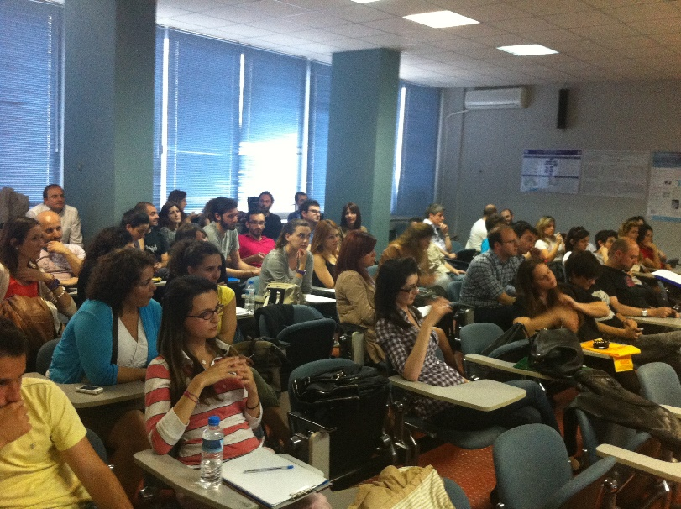
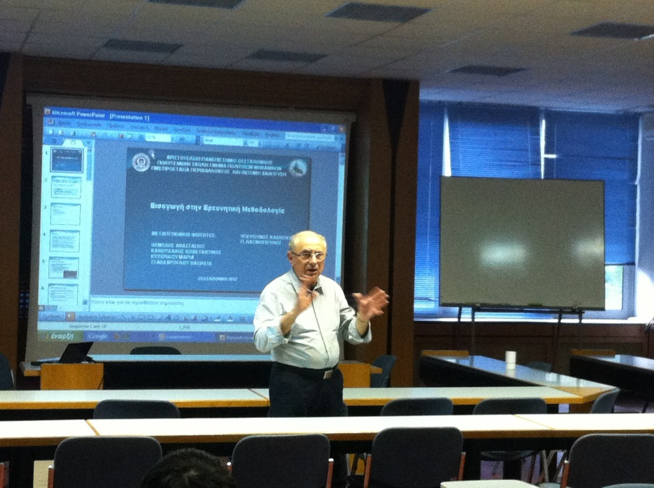
Implementation of the course
Class participation and attendance
a manageable class of 30-66 students (annual average: 47)
due to course’s seminar-type attending classes is critical
a fairly strict mandatory attendance policy is imposed
observed students average absenteeism is low

Slide 8
Implementation of the course
Class participation and attendance
(a) class composition PhD’s / MSC’s (41,5% / 59,5%)
664
275 PhDs - 389 PostGrads

Slide 9
Implementation of the course
Class participation and attendance
(b) class composition CE’s / Others (66,5% / 33,5%)
664
442 CEs - 222 Others

Slide 10
Implementation of the course
Class participation and attendance
Engineering specialisations
RS Rural and Surveying
PL Planning and Regional Development
AR Architecture
ME Mechanical
EN Environmental
CE Chemical
EL Electrical
PA Production & Administration
222 non-civil engineers
1
2
Other disciplines
FO Forestry
GL Geology
ES Environmental Studies
AG Agriculture
PH Physics
CH Chemistry
IND All other individual disciplines (4 or less)
3
3
2
1

Slide 11
Implementation of the course
Course schedule
Week | Event / Topic | Student Assignment / Activity
1 | Lecture 1 Basic concepts of scientific research
2 | Lecture 2 Research methodology and ethics | General assignment
3 | Lecture 3 Literature review and management
4 | Lecture 4 Technical terminology | Specific assignment A
5 | Lecture 5 Quantitative research methods
6 | Lecture 6 Oral presentations
7 | Students activity 1 Oral presentations of paper critiques | Presentations and discussion of the critiques of journal papers
8 | Lecture 7 Posters and diagrams
9 | Lecture 8 Academic & scientific writing | Specific assignment B
10 | Students activity 2 Conference | Formal presentations (oral with PPTs) and posters display

Slide 12
Implementation of the course
Course assignments
General assignment
Specific assignment A
Paper critique
- literature search/paper selection
- critical analysis/evaluation
- oral presentation of critique
Paper presentation
- reverse use of paper
- oral presentation of paper
Poster preparation & presentation
- poster presentation of paper
technical terminology in research
(principles, sources, proper use)
elaboration of selected terms
(term and definition evaluation, translation)
Specific assignment B
preparation of a conference paper
(on current personal research issues)
multiple evaluation criteria
(scientific merit, content, compliance with formatting requirements)

Slide 13
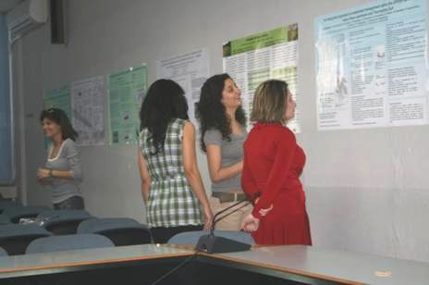
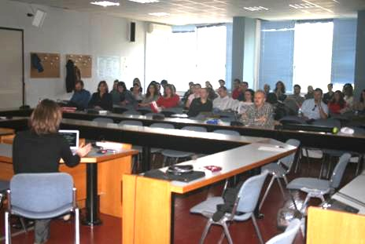
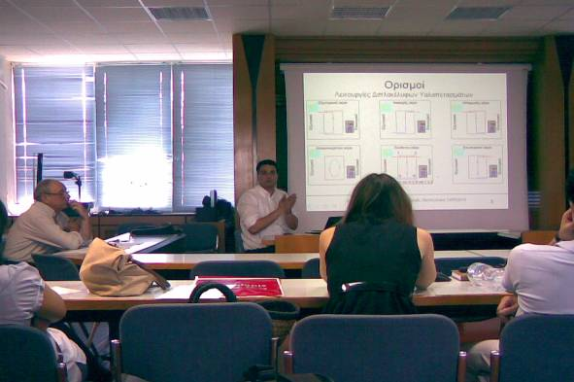
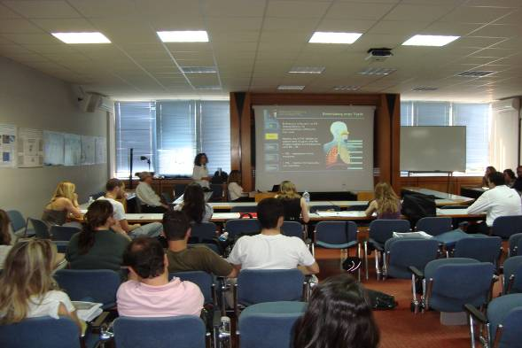
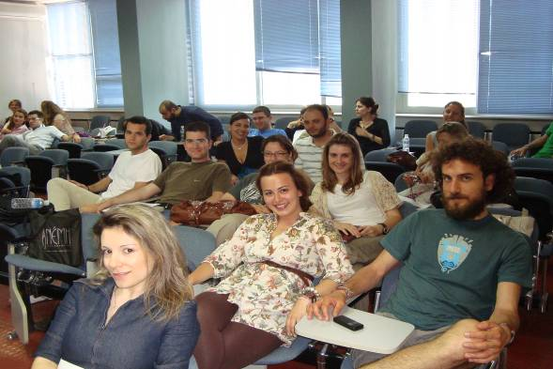
Implementation of the course
The conference
The concluding activity of the course
various roles
- chairpersons
- speakers
- poster presenters
- audience
more benefits
- presentation and discussion of various scientific issues

Slide 14
Conclusions
Restructuring doctoral studies
Doctoral education in Europe
a dynamically changing educational issue
Doctoral education aims
EUA-CDE brings together the largest community of academic leaders and professionals working on doctoral education and research training
research-related knowledge acquisition
specific skills development
The presented course
an integrated educational form
a flexible/modifiable assembly of subjects
specifically designed for engineers
suitable for MSc’s & PhD’s at early stages
personal supervision required at later stages

Slide 15
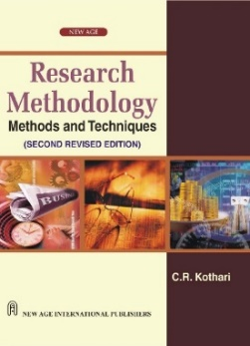
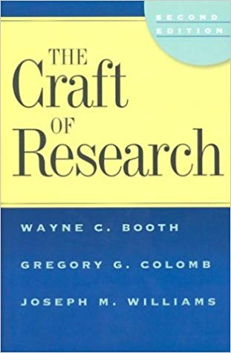
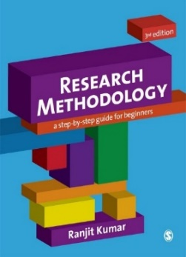
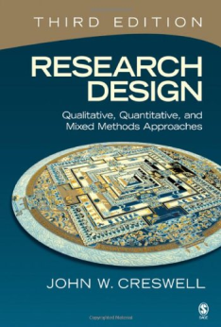
Bibliography
A vast collection of books, reports and articles

Slide 16
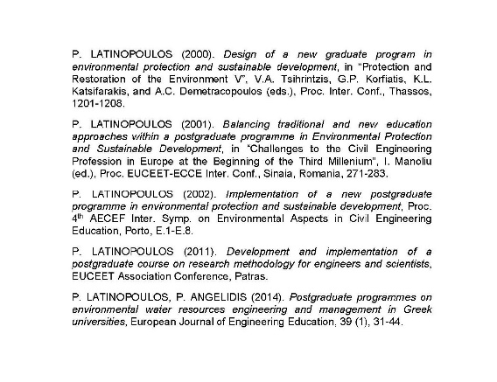
Bibliography
Personal contribution
The first steps in research: a practical guide for young researchers P. Latinopoulos (2010) (in Greek)

Slide 17
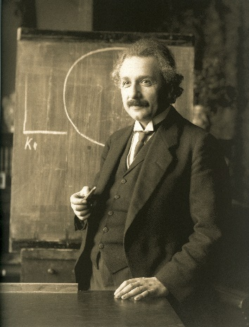
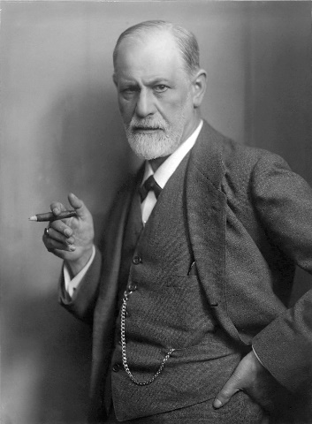
Famous Quotes on Research
If we knew what it was we were doing, it would not be called research, would it?
ALBERT EINSTEIN
The great question that has never been answered, and which I have not yet been able to answer, despite my thirty years of research into the feminine soul, is:
'What does a woman want?’
SIGMUND FREUD

